Slide 1
Filters – Part A
Linear Circuit Analysis II
EECE 202 – Spring 2025

Slide 2
Announcement
Midterm during week 8
PD 1 Voice Over PPT due in Week 10

Slide 3
Recap
Transfer functions
Initial and final value theorem
New Material
Filters
Filter Type
Transfer function of a filter
Cutoff frequency

Slide 4
Filters
The water filter separates water from other impurities like sand, salts, solid particles, etc.
Likewise, Electric/Electronic Filters separate the “required signal” from other “unwanted signals”.
In Electric/Electronic Filters, we separate signals on the basis of their frequencies.
In other words, The Electric/Electronic Filter is a circuit or device that passes a signal with a certain frequency and blocks signals with all other frequencies.
Also, The Electric/Electronic Filter can pass signals with a certain range of frequencies and blocks what is outside this range.

Slide 5
Filters and Signals: What Does a Filter Do?
Ideally, a filter will not add new frequencies to the input signal, nor will it change the component frequencies of that signal, but it will change the relative amplitudes of the various frequency components and/or their phase relationships
Consider a situation where a useful signal at frequency f₁ has been contaminated with an unwanted signal at f₂. If the contaminated signal is passed through a circuit that has very low gain at f₂ compared to f₁, the undesired signal can be removed, and the useful signal will remain.

Slide 6
Filters Types
Low Pass Filter (LPF)
High Pass Filter (HPF)
Band Pass Filter (BPF)

Slide 7
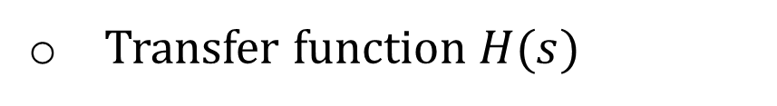
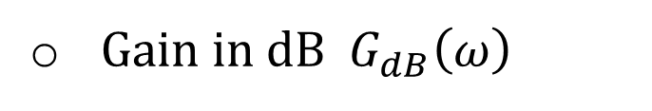
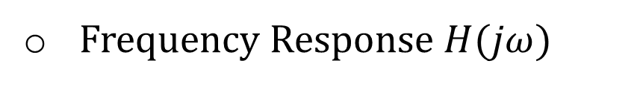
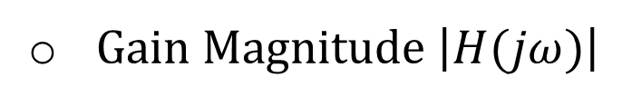
Filters Description
A filter can be described through one of the following :
Transfer function $H(s)$
Frequency Response $H(jω)$
Gain Magnitude $\left|H(jω)\right|$
Gain in dB $G_{dB}\left(ω\right)$

Slide 8
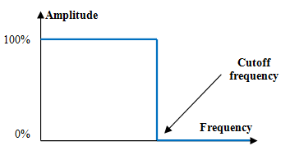
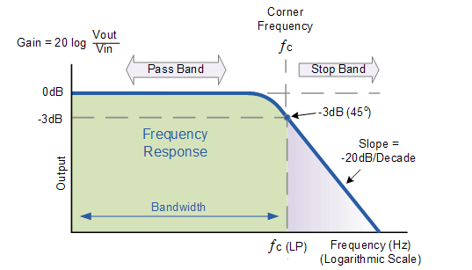
Low Pass Filter (LPF)
The ideal Low pass filter passes signals with frequencies below a certain value (f_{c}), and blocks frequencies above this value. This value (f_{c}) as shown in the figure (shows ideal filter) is called the cutoff frequency.
In the real Low pass filter the signal at the cutoff frequency (f_{c}) is attenuated to 70.7% (-3 dB) of its original amplitude.
The frequencies below this f_{c} is called “Pass Band”, and the frequencies above the f_{c} is called the “Stop Band”.

Slide 9
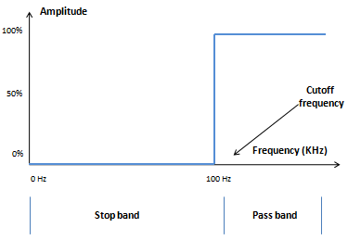
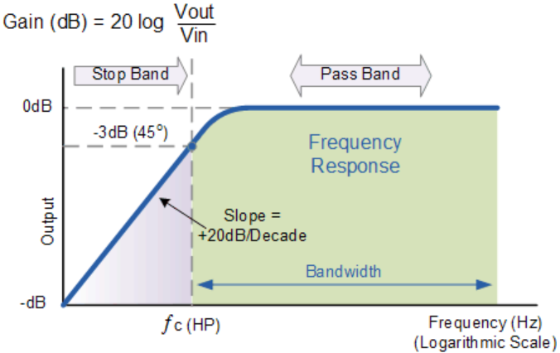
High Pass Fiter (HPF)
The ideal High pass filter passes signals with frequencies above a certain value (f_{c}), and blocks frequencies below this value. This value (f_{c}) as shown in the figure (shows ideal filter) is called the cutoff frequency.
In the real High pass filter the signal at the cutoff frequency (f_{c}) is attenuated to 70.7% (-3 dB) of its original amplitude.
The frequencies above this f_{c} is called “Pass Band”, and the frequencies below the f_{c} is called the “Stop Band”.

Slide 10
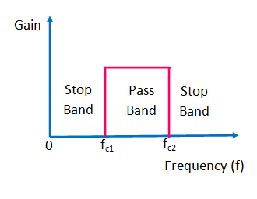
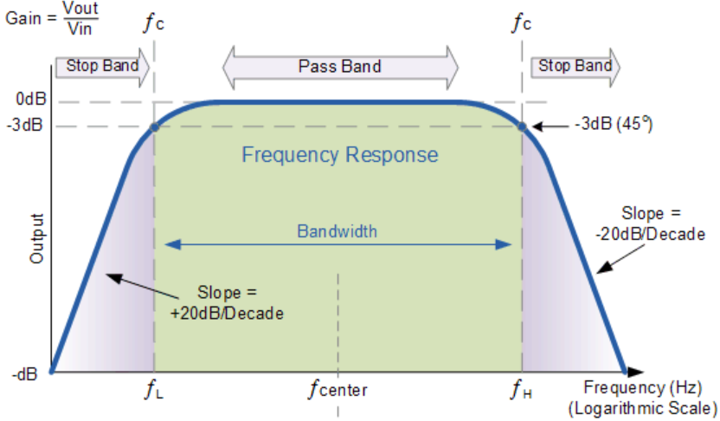
Band Pass Filter (BPF)
The ideal Band pass filter passes signals with frequencies between certain values (f_{c1}, f_{c2}), and blocks frequencies outside these values. These values (f_{c1}, f_{c2}) as shown in the figure (shows ideal filter) is called the cutoff frequencies.
In the real band pass filter the signal at the cutoff frequency (f_{c1} and f_{c2}) are attenuated to 70.7% (-3 dB) of its original amplitude.
The frequencies in between these f_{c1} and f_{c2} are called “Pass Band”, and the frequencies outside the f_{c1} and f_{c2} are called the “Stop Band”.

Slide 11
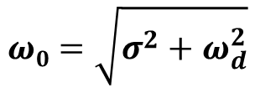

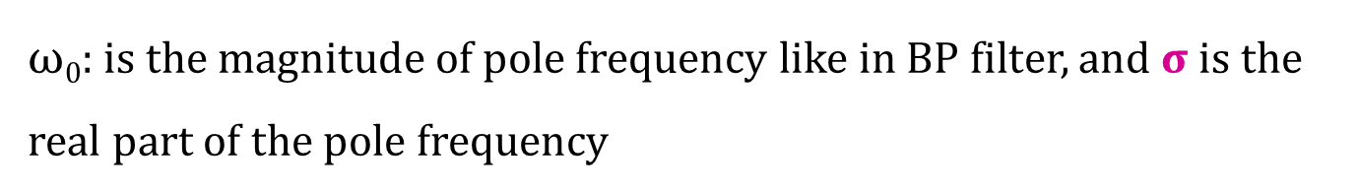
Low Pass Filter (LPF)
A low-pass filter passes low frequency signals, and rejects signals at frequencies above the filter's cutoff frequency,
The poles of the TF are : P_{1,2} = -σ ± j$ω$_{d}
$ω$₀: is the magnitude of pole frequency like in BP filter, and σ is the real part of the pole frequency
The peak frequency is :
$$ω\text{0}=\sqrt{σ^{2}+ω_{d}^{2}}$$

Slide 12
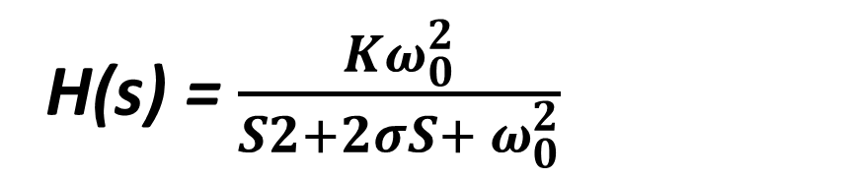
salman
Low Pass Filter (LPF)
A low-pass filter passes low frequency signals, and rejects signals at frequencies above the filter's cutoff frequency,
H(s) = $\frac{Kω_{0}^{2}}{S2+2σS+ ω_{0}^{2}}$
The poles of the TF are : P_{1,2} = -σ ± j$ω$_{d}
$ω$₀: is the magnitude of pole frequency like in BP filter, and σ is the real part of the pole frequency
The peak frequency is :
$$ω\text{0}=\sqrt{σ^{2}+ω_{d}^{2}}$$

Slide 13
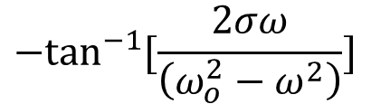
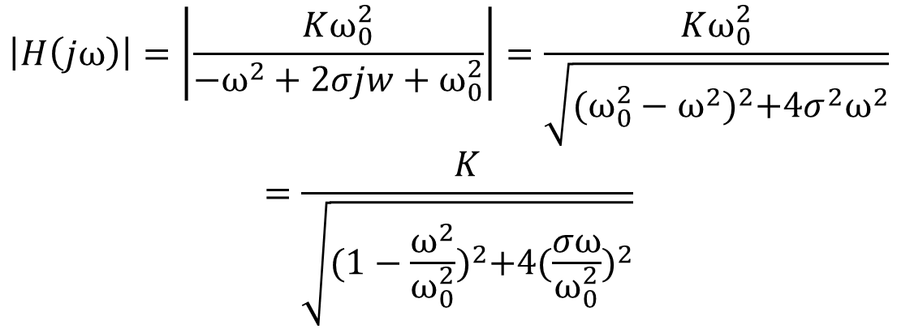
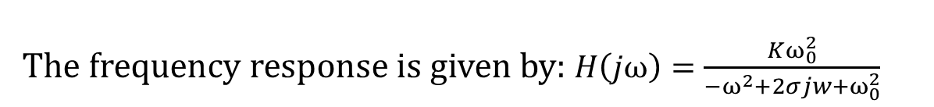
Low Pass Filter (LPF)
The frequency response is given by: $H\left(jω\right)=\frac{Kω_{0}^{2}}{−ω^{2}+2σjw+ω_{0}^{2}}$
The gain magnitude (amplitude) is given by:
$$\left|H\left(jω\right)\right|=\left|\frac{Kω_{0}^{2}}{−ω^{2}+2σjw+ω_{0}^{2}}\right|=\frac{Kω_{0}^{2}}{\sqrt{{(ω_{0}^{2}−ω^{2})}^{2}+4σ^{2}ω^{2}}}$$
$$=\frac{K}{\sqrt{{(1−\frac{ω^{2}}{ω_{0}^{2}})}^{2}+4{(\frac{σω}{ω_{0}^{2}})}^{2}}}$$
The phase response is given by:
$${−tan}^{−1}{[\frac{2σω}{\left(ω_{o}^{2}−ω^{2}\right)}]}$$

Slide 14
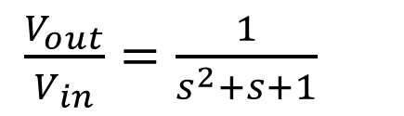
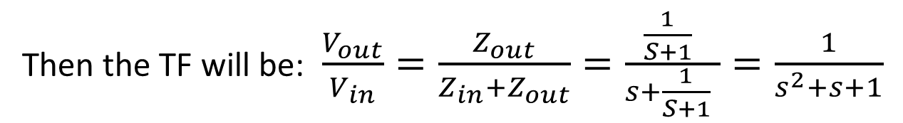
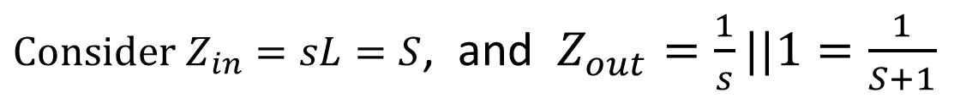
Example - Low Pass Filter (LPF)
1-Find the transfer function of the shown circuit.
2-What kind of filter does it represent ?
3-Find the peak frequency (ω_{o}) and the gain factor “K”.
${Consider Z}_{in}=sL=S$, and $Z_{out}=\frac{1}{s}||1=\frac{1}{S+1}$
Then the TF will be: $\frac{V_{out}}{V_{in}}=\frac{Z_{out}}{Z_{in}+Z_{out}}=\frac{\frac{1}{S+1} }{s+\frac{1}{S+1} }=\frac{1}{s^{2}+s+1}$
There is no “s” on the numerator, then this is a Low Pass Filter.
By matching the below 2 equations, we can easily find $ω_{0}$=1, and K =1
&
$\frac{V_{out}}{V_{in}}=\frac{1}{s^{2}+s+1}$

Slide 15
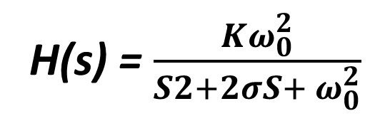
salman
Example - Low Pass Filter (LPF)
1-Find the transfer function of the shown circuit.
2-What kind of filter does it represent ?
3-Find the peak frequency (ω_{o}) and the gain factor “K”.
${Consider Z}_{in}=sL=S$, and $Z_{out}=\frac{1}{s}||1=\frac{1}{S+1}$
Then the TF will be: $\frac{V_{out}}{V_{in}}=\frac{Z_{out}}{Z_{in}+Z_{out}}=\frac{\frac{1}{S+1} }{s+\frac{1}{S+1} }=\frac{1}{s^{2}+s+1}$
There is no “s” on the numerator, then this is a Low Pass Filter.
By matching the below 2 equations, we can easily find $ω_{0}$=1, and K =1
H(s) = $\frac{Kω_{0}^{2}}{S2+2σS+ ω_{0}^{2}}$
&
$\frac{V_{out}}{V_{in}}=\frac{1}{s^{2}+s+1}$

Slide 16
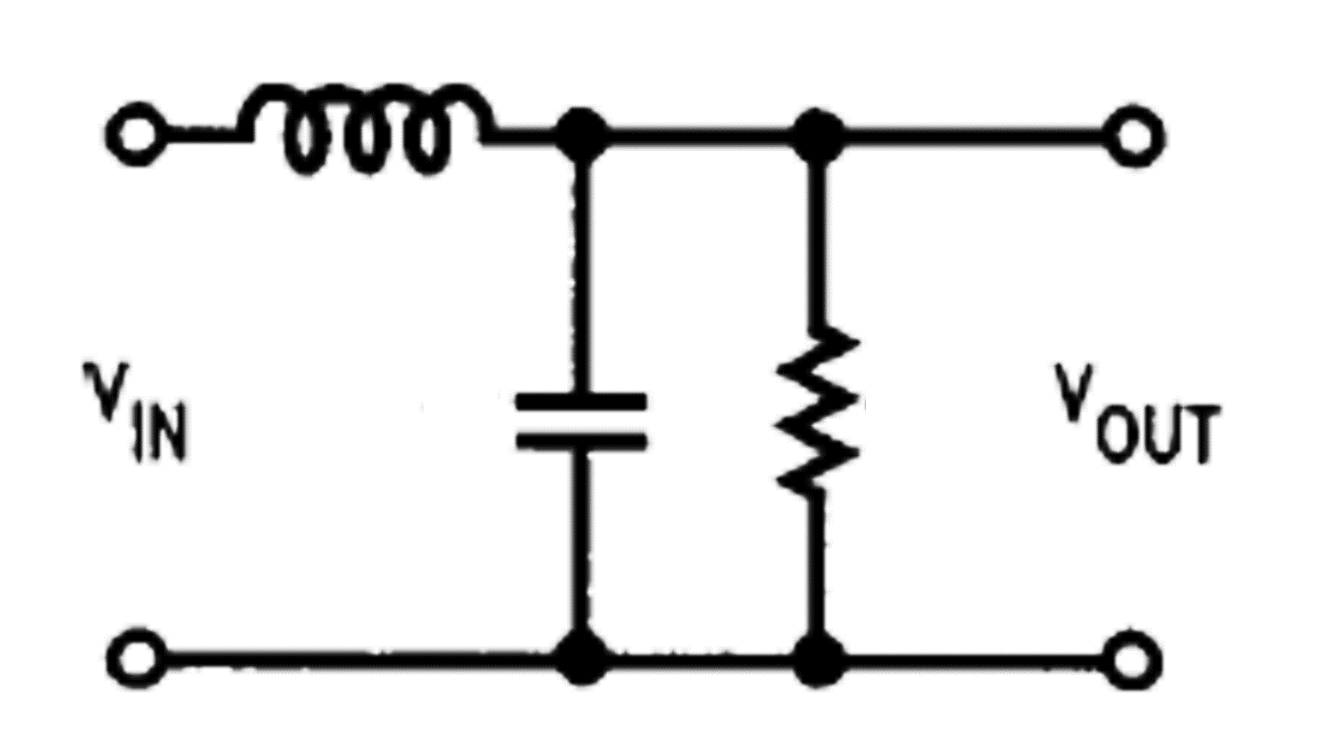
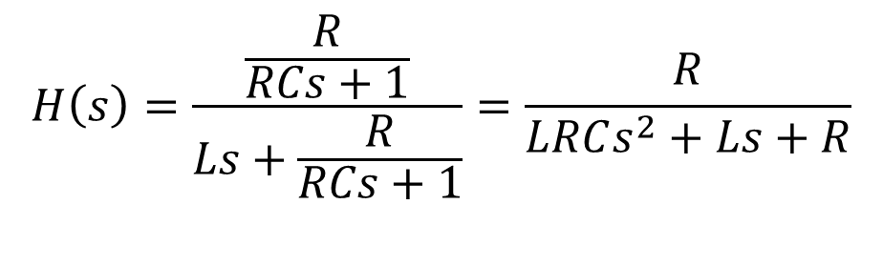
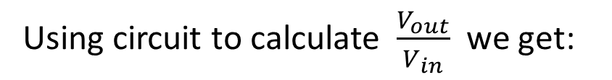
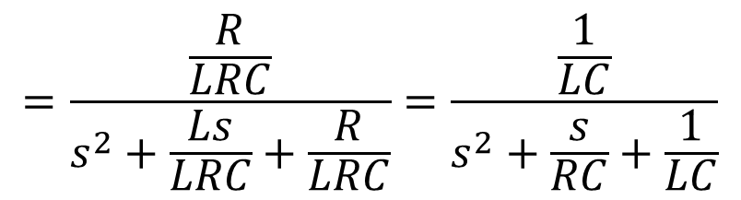
Example - Low Pass Filter (LPF)
L
Design the filter shown in the figure so that the peak frequency “f_{o}” is 1000 Hz.
This is a LPF with the following generic TF:
C
R
Using circuit to calculate $\frac{V_{out}}{V_{in}}$ we get:
$$H\left(s\right)=\frac{\frac{R}{RCs+1}}{Ls+\frac{R}{RCs+1}}=\frac{R}{LRCs^{2}+Ls+R}$$
$$=\frac{\frac{R}{LRC}}{s^{2}+\frac{Ls}{LRC}+\frac{R}{LRC}}=\frac{\frac{1}{LC}}{s^{2}+\frac{s}{RC}+\frac{1}{LC}}$$

Slide 17
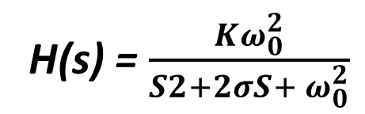
salman
Example - Low Pass Filter (LPF)
L
Design the filter shown in the figure so that the peak frequency “f_{o}” is 1000 Hz.
This is a LPF with the following generic TF:
C
R
H(s) = $\frac{Kω_{0}^{2}}{S2+2σS+ ω_{0}^{2}}$
Using circuit to calculate $\frac{V_{out}}{V_{in}}$ we get:
$$H\left(s\right)=\frac{\frac{R}{RCs+1}}{Ls+\frac{R}{RCs+1}}=\frac{R}{LRCs^{2}+Ls+R}$$
$$=\frac{\frac{R}{LRC}}{s^{2}+\frac{Ls}{LRC}+\frac{R}{LRC}}=\frac{\frac{1}{LC}}{s^{2}+\frac{s}{RC}+\frac{1}{LC}}$$

Slide 18
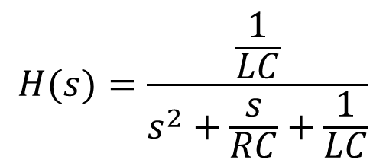
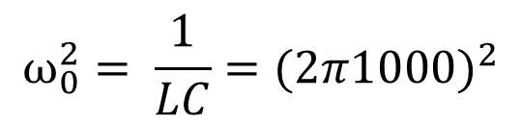
Then we find the following TF based on circuit analysis:
$$H(s)=\frac{\frac{1}{LC}}{s^{2}+\frac{s}{RC}+\frac{1}{LC}}$$
By comparing the above TF with the general TF of that of the LPF.
$$ω_{0}^{2}= \frac{1}{LC}=(2π1000)^{2}$$
We find that:
Since we have 3 unknowns and one equation. We can assume the values of 2 unknowns and compute the 3rd.
Assume R=1Ω and L=1H.
$$∴ \frac{1}{LC}=3.94×{10}^{7}, substitute for L=1 ∴C≅25 nF$$

Slide 19
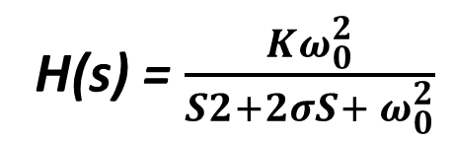
salman
Then we find the following TF based on circuit analysis:
$$H(s)=\frac{\frac{1}{LC}}{s^{2}+\frac{s}{RC}+\frac{1}{LC}}$$
By comparing the above TF with the general TF of that of the LPF.
H(s) = $\frac{Kω_{0}^{2}}{S2+2σS+ ω_{0}^{2}}$
$$ω_{0}^{2}= \frac{1}{LC}=(2π1000)^{2}$$
We find that:
Since we have 3 unknowns and one equation. We can assume the values of 2 unknowns and compute the 3rd.
Assume R=1Ω and L=1H.
$$∴ \frac{1}{LC}=3.94×{10}^{7}, substitute for L=1 ∴C≅25 nF$$

Slide 20
Answer the following questions using ChatGPT
What is the primary function of an electronic filter in a circuit
How does a Low Pass Filter (LPF) affect signals above its cutoff frequency?
What is the significance of the -3 dB point in a filter's frequency response?
How does the step response of a system differ from its impulse response, and what does it indicate about the system's stability?
How can you find out the type of filter?

Slide 21
.
Summary
Filters in electronics separate required signals from unwanted ones based on frequency.
They selectively pass certain frequencies (pass band) and block others (stop band)
Low Pass Filter (LPF): Passes signals below a cutoff frequency, blocking higher frequencies.
High Pass Filter (HPF): Passes signals above a cutoff frequency, blocking lower frequencies.
Band Pass Filter (BPF): Passes signals between two cutoff frequencies, blocking signals outside this range
Transfer Function H(s) represents the mathematical relationship between input and output.
Frequency Response H(jω) describes how the filter responds to different frequencies.

